Slide 1
Topic B: The particulate nature of matter B.5 – Current and circuits
Guiding questions
How do charged particles flow through materials?
How are the electrical properties of materials quantified?
What are the consequences of resistance in conductors?
Notes:
© 2014 By Timothy K. Lund

Slide 2
Topic B: The particulate nature of matter B.5 – Current and circuits
Understandings:
Students should understand:
• that cells provide a source of emf
• chemical cells and solar cells as the energy source in circuits
• that circuit diagrams represent the arrangement of components in a circuit
• direct current (dc) I as a flow of charge carriers as given by I = Δq/Δt
• that the electric potential difference V is the work done per unit charge on moving a positive charge
between two points along the path of the current as given by V = W/q
• the properties of electrical conductors and insulators in terms of mobility of charge carriers
Notes:
‹#›
© 2014 By Timothy K. Lund

Slide 3
Topic B: The particulate nature of matter B.5 – Current and circuits
Understandings:
Students should understand:
• electric resistance and its origin
• electrical resistance R as given by R = V/I
• resistivity as given by ρ = RA/L
• Ohm’s law
• the ohmic and non-ohmic behaviour of electrical conductors, including the heating effect of resistors
•electrical power P dissipated by a resistor as given by P = IV = I²R = V²/R
• the combinations of resistors in series and parallel circuits
• that electric cells are characterized by their emf ε and internal resistance r as given by ε = I(R + r)
• that resistors can have variable resistance.
Notes:
‹#›
© 2014 By Timothy K. Lund

Slide 4
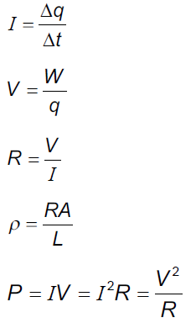
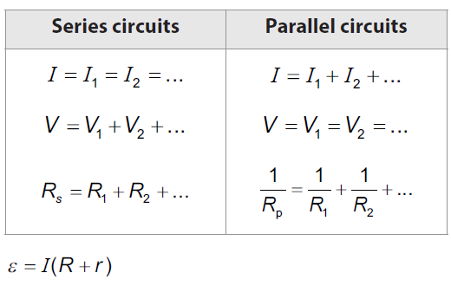
Topic B: The particulate nature of matter B.5 – Current and circuits
Data booklet reference:
Notes:
‹#›
© 2014 By Timothy K. Lund

Slide 5
Topic B: The particulate nature of matter B.5 – Current and circuits
Charge
∙In a simplified atomic model, electrons orbit about a central nucleus:
∙As long as the number of electrons equals the number of protons, an atom is neutral.
∙If an electron is removed from an atom, the atom has a net (+) charge and becomes a positive ion.
∙If an electron is added to an atom, the atom has a net (-) charge and is called a negative ion.
Proton (+)
Neutron (0)
Electron (-)
NEGATIVE ION
POSITIVE ION
N E U T R A L
N E U T R A L
HYDROGEN
BERYLLIUM
Notes:
© 2006 By Timothy K. Lund

Slide 6
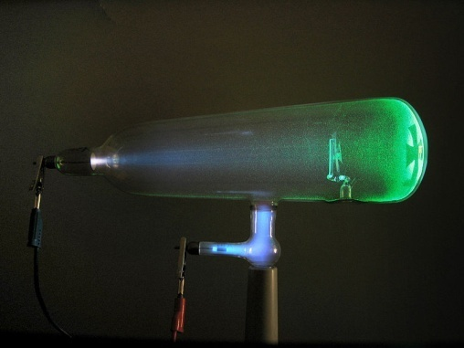
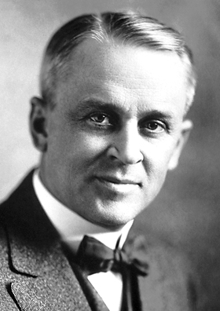
Topic B: The particulate nature of matter B.5 – Current and circuits
Charge – the elementary charge e
∙Although we like to consider the charge of an electron -1 and the charge of a proton +1, it turns out the actual charge of each is given in terms of the elementary charge e.
∙Sir William Crookes used his cathode ray tube to demonstrate the electrons were negatively charged.
∙Physicists Robert Millikan and Harvey Fletcher performed the famous oil-drop experiment to determine the actual value of the charge of an electron in 1909 (see details at the end of D.2)
1e = 1.60×10⁻¹⁹ C
the elementary charge
Notes:
© 2006 By Timothy K. Lund

Slide 7




Topic B: The particulate nature of matter B.5 – Current and circuits
Charge
∙A simple experiment can demonstrate not only the “creation” of charges, but a simple force rule.
∙If we rub a rubber balloon on a piece of wool, the balloon strips electrons from the wool, and captures them.
∙Thus the wool becomes (+) and the balloon (-).
Notes:
© 2006 By Timothy K. Lund

Slide 8
Topic B: The particulate nature of matter B.5 – Current and circuits
Charge – the charge law
∙We find that the green and the orange balloons repel each other.
∙We find that the wool samples repel each other.
∙We can thus state that like charges repel.
Notes:
© 2006 By Timothy K. Lund

Slide 9
Topic B: The particulate nature of matter B.5 – Current and circuits
Charge – the charge law
∙We also find that the balloons are attracted to the wool samples, any way we combine them.
∙We can thus state that unlike charges attract.
Notes:
© 2006 By Timothy K. Lund

Slide 10
Topic B: The particulate nature of matter B.5 – Current and circuits
Charge – the charge law
∙The previous slides tell us then that there are two types of charge: positive and negative.
∙And that like charges repel and unlike charges attract.
FYI
It is well to state here that the charge law is a model that represents some sort of behavior involving a physical property called “charge.”
We use (+) and (-) to represent these properties only because they are convenient and familiar to us.
In Topic 7 we will learn of another type of charge called color charge. A 3-color model will be used then.
Notes:
© 2006 By Timothy K. Lund

Slide 11
Topic B: The particulate nature of matter B.5 – Current and circuits
Charge – the conservation of charge
∙If you compare the original balloon-wool sample pairings you will see that for every (-) transferred to the balloon, there is exactly one (+) left behind on the wool.
∙Careful observation shows us that there are 15 (+) charges on the wool, and 15 (-) charges on the balloon for a total (or net) charge of ZERO.
∙Given that neither the wool nor the balloon had any net charge before the rubbing process, we see that we have created NO NET CHARGE during the rubbing process.
Notes:
© 2006 By Timothy K. Lund

Slide 12
Topic B: The particulate nature of matter B.5 – Current and circuits
Charge – the conservation of charge
∙This leads us to another conservation law. The law of conservation of charge states that charge can be neither created nor destroyed.
∙Obviously charge can be transferred from one object to another.
∙Thus we can build up a negative charge on a balloon, but only at the expense of leaving behind an equal positive charge on a wool sweater.
FYI
Conservation of charge is never violated, as we will see when we talk of nuclear and particle physics, whereas conservation of mass is sometimes violated.
Notes:
© 2006 By Timothy K. Lund

Slide 13
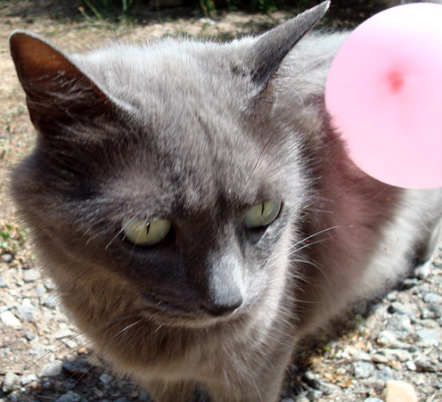
Topic B: The particulate nature of matter B.5 – Current and circuits
Charge – the conservation of charge
PRACTICE: A cat’s fur, like your hair, acts just like wool when you rub a balloon on it. A balloon has picked up -150 μC of charge from Albert. The resulting opposite charges of balloon and Albert cause the balloon to stick.
How many electrons have been transferred?
(b) What is the charge on Albert?
SOLUTION: Use 1 e⁻ = -1.60×10⁻¹⁹ C so…
(a) n = (-150×10⁻⁶ C)(1 e⁻ / -1.60×10⁻¹⁹ C) = 9.4×10¹⁴ e⁻.
(b) Conservation of charge tells us that
q_{Albert} = +150 μC.
Notes:
© 2006 By Timothy K. Lund

Slide 14
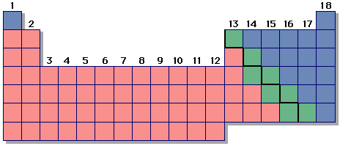
Topic B: The particulate nature of matter B.5 – Current and circuits
Charge – conductors and nonconductors
∙Materials can be divided into three categories:
(1) Conductors - which easily transport electrons without trying to capture or impede them,
(2) Nonconductors or insulators - which capture or impede electrons, and
(3) Semiconductors - which lie between conductors and insulators.
∙Roughly speaking, metals are good conductors, nonmetals are good insulators, and metalloids are good semiconductors.
Notes:
© 2006 By Timothy K. Lund

Slide 15
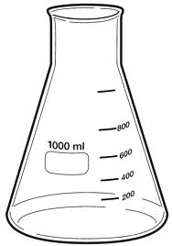
Topic B: The particulate nature of matter B.5 – Current and circuits
Charge – detection using an electroscope
EXAMPLE: An electroscope is a primitive instrument that can be used to detect electrical charge.
∙A glass Erlenmeyer flask has a rubber stopper with a hole in it. Both the rubber stopper and the glass are insulators.
∙A conductor is passed through a hole.
∙At the outside end of the conductor is a conducting ball.
∙On the inside end of the conductor are 2 very thin and flexible gold filaments that hang under their own weight. Gold is also a conductor.
Notes:
© 2006 By Timothy K. Lund

Slide 16
Topic B: The particulate nature of matter B.5 – Current and circuits
Charge – detection using an electroscope
EXAMPLE: An electroscope is a primitive instrument that can be used to detect electrical charge.
∙The idea is that you can place a charge on the ball, and the conductors of the scope will allow the charge to spread out, all the way to the gold filaments.
∙When the charge reaches the filaments, since each filament has some of the original charge, the filaments will repel.
∙When the filaments repel you can tell, because they spread out from one another.
Notes:
© 2006 By Timothy K. Lund

Slide 17
Topic B: The particulate nature of matter B.5 – Current and circuits
Charge – detection using an electroscope
PRACTICE: Consider the three electroscopes shown.
Which one has the greatest charge in the filaments?
Which one has the least?
Can you tell whether the charge is (+) or (-)? Why?
SOLUTION:
∙The last one has the most charge, the middle one the least.
∙You cannot tell the sign of the charge since (-)(-) will repel, but so will (+)(+).
Notes:
© 2006 By Timothy K. Lund

Slide 18
Topic B: The particulate nature of matter B.5 – Current and circuits
Charge – detection using an electroscope
PRACTICE: Explain: A charged wand is brought near an uncharged electroscope without touching it. While the wand is near, the filaments spread out.
SOLUTION:
∙The ball and the filaments are conductors and they are connected to each other.
∙The wand’s charge repels like charges in the ball.
∙The like charges in the ball travel as far as they can to the filaments.
∙The filaments now temporarily hold like charges and thus they repel each other.
before and after
during
Notes:
© 2006 By Timothy K. Lund

Slide 19
Topic B: The particulate nature of matter B.5 – Current and circuits
Electric current
∙Electric current I is the time rate ∆t at which charge ∆q moves past a particular point in a circuit.
∙From the formula it should be clear that current is measured in Coulombs per second (C s⁻¹) which is called an Ampere (A)
I = ∆q / ∆t
or I = q / t
electric current
PRACTICE: Many houses have 20-amp(ere) service. How many electrons per second is this?
SOLUTION:
∙20 A is 20 C (per s) so we only need to know how many electrons are in 20 C.
(20 C)(1 e⁻ / 1.6×10⁻¹⁹ C) = 1.3×10²⁰ e⁻.
Notes:
© 2006 By Timothy K. Lund

Slide 20
Topic B: The particulate nature of matter B.5 – Current and circuits
Electric current
∙Electric current I is the time rate ∆t at which charge ∆q moves past a particular point in a circuit.
∙A simple model may help clarify current flow.
∙Think of conductors as “pipes” that hold electrons.
∙The chemical cell pushes an electron out of the (-) side. This electron in turn pushes the next, and so on, because like charges repel.
∙This “electromotive force” is transfered simultaneously to every charge in the circuit.
Notes:
© 2006 By Timothy K. Lund

Slide 21
Topic B: The particulate nature of matter B.5 – Current and circuits
Electric current
∙Electric current I is the time rate ∆t at which charge ∆q moves past a particular point in a circuit.
EXAMPLE: Suppose each (-) represents an electron. Find the current in electrons per second and then convert it to amperes.
SOLUTION: Choose a reference and start a timer.
∙The rate is about 7 electrons each 12 s or I = 7/12 = 0.58 e⁻ s⁻¹.
∙I = (0.58 e⁻ s⁻¹)(1.6×10⁻¹⁹ C/1 e⁻) = 9.3×10⁻²⁰ A.
Notes:
© 2006 By Timothy K. Lund

Slide 22
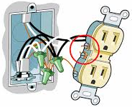
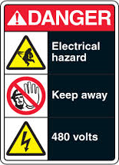
Topic B: The particulate nature of matter B.5 – Current and circuits
Electric current
EXAMPLE: Explain why when a wire is cut current stops everywhere and does not “leak” into the air.
SOLUTION:
∙Freeing an e⁻ from a conductor takes a lot of energy.
∙This is why you don’t get electrocuted by e⁻ jumping off of nearby conductors like outlets (unless the voltage is very high).
∙This is also why when you cut the wire e⁻ do not leak out into the surrounding environment.
∙Finally, if the chain is broken the push stops, so the current stops everywhere.
Notes:
© 2006 By Timothy K. Lund

Slide 23
Topic B: The particulate nature of matter B.5 – Current and circuits
Potential difference (voltage) – explored further in D.2
∙Because electric charges experience the electric force, when one charge is moved in the vicinity of another, work W is done (recall that work is a force times a displacement).
∙We define the potential difference V at any point A and B as the amount of work W done per unit charge in moving a point charge from A to B.
∙Note that the units of V are JC⁻¹ which are volts V.
Q
q
A
B
V = V_{B} – V_{A} = W / q
potential difference
Notes:
© 2006 By Timothy K. Lund

Slide 24
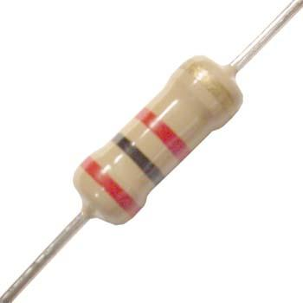
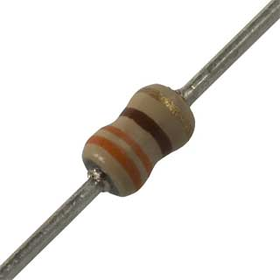
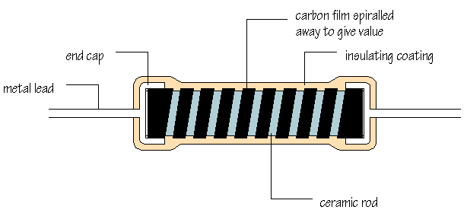
Topic B: The particulate nature of matter B.5 – Current and circuits
Resistance
∙If you have ever looked inside an electronic device you have no doubt seen what a resistor looks like.
∙A resistor’s working part is usually made of carbon, which is a semiconductor.
∙The less carbon there is, the harder it is for current to flow through the resistor.
∙As the animation shows, carbon is spiraled away to cut down the cross-sectional area, thereby increasing the resistance to whatever value is desired.
Notes:
‹#›
© 2006 By Timothy K. Lund

Slide 25
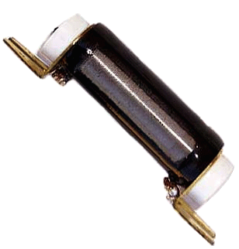

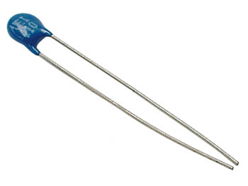
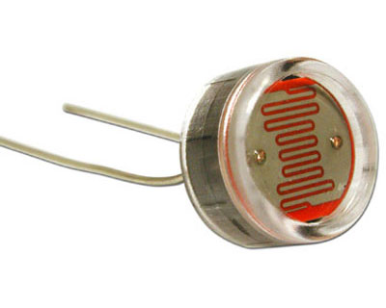
Topic B: The particulate nature of matter B.5 – Current and circuits
Resistance
∙Some very precise resistors are made of wire and are called wire-wound resistors.
∙And some resistors can be made to vary their resistance by tapping them at various places. These are called variable resistors and potentiometers.
∙Thermistors are temperature- dependent resistors, changing their resistance in response to their temperature.
∙Light-dependent resistors (LDRs) change their resistance in response to light intensity.
Notes:
‹#›
© 2006 By Timothy K. Lund

Slide 26
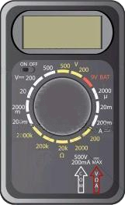
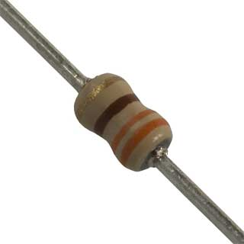

Topic B: The particulate nature of matter B.5 – Current and circuits
Resistance
∙Electrical resistance R is a measure of how hard it is for current to flow through a material. Resistance is measured in ohms (Ω) using an ohm-meter.
0.L
This resistor has a resistance of 330.4 Ω.
0.0
330.4
FYI
∙A reading of 0.L on an ohmeter means “overload”. The resistance is too high to record with the meter.
Notes:
‹#›
© 2006 By Timothy K. Lund

Slide 27


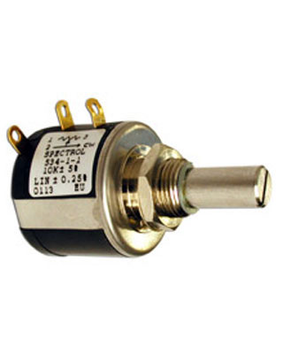

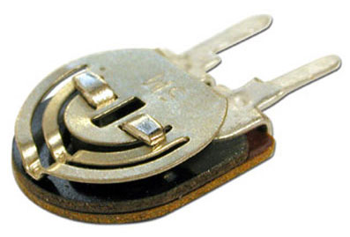
Topic B: The particulate nature of matter B.5 – Current and circuits
Resistance
∙The different types of resistors have different schematic symbols.
fixed-value resistor
2 leads
potentiometer
3 leads
variable resistor
2 leads
Notes:
‹#›
© 2006 By Timothy K. Lund

Slide 28


Topic B: The particulate nature of matter B.5 – Current and circuits
Resistance
∙The different types of resistors have different schematic symbols.
light-dependent resistor (LDR)
thermister
2 leads
2 leads
As temperature increases resistance decreases
As brightness increases resistance decreases
Notes:
‹#›
© 2006 By Timothy K. Lund

Slide 29
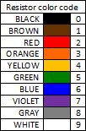
Topic B: The particulate nature of matter B.5 – Current and circuits
Resistance
∙The resistance R of a material is the ratio of the potential difference V across the material to the current I flowing through the material.
∙The units from the formula are (V A⁻¹) which are called ohms (Ω).
R = V / I
electric resistance
PRACTICE:
A fixed resistor has a current of 18.2 mA when it has a 6.0 V potential difference across it. What is its resistance?
SOLUTION:
∙ R = V / I = 6.0 / 18.2×10⁻³ = 330 Ω.
Orange = 3
Orange = 3
Brown = 1
Last color is number of zeros.
Notes:
‹#›
© 2006 By Timothy K. Lund

Slide 30
Topic B: The particulate nature of matter B.5 – Current and circuits
Resistance
∙To understand electrical resistance, consider two identical milk shakes.
∙In the first experiment the straws have the same diameter, but different lengths.
∙In the second experiment the straws have the same length, but different diameters.
∙Note that R ∝ L / A.
Resistance is a measure of how hard it is to pass something through a material.
R ∝ L
R ∝ 1 / A
Notes:
‹#›
© 2006 By Timothy K. Lund

Slide 31
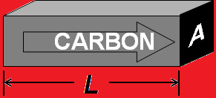
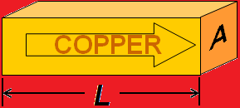
Topic B: The particulate nature of matter B.5 – Current and circuits
Resistance
∙Of course conductors and resistors are not hollow like straws. And instead of milk shake current we have electrical current.
∙Even through solids R ∝ L / A.
∙But R also depends on the material through which the electricity is flowing.
∙For example the exact same size of copper will have much less resistance than the carbon.
∙With the proportionality constant ρ we have equality:
R = ρL / A or ρ = RA / L
resistance equation
Notes:
‹#›
© 2006 By Timothy K. Lund

Slide 32
Topic B: The particulate nature of matter B.5 – Current and circuits
Resistance
∙The Greek ρ is the resistivity of the particular material the resistor is made from. It is measured in Ωm.
Resistivities and Temperature Coefficients for Various Materials at 20°C
Material
ρ (Ω⋅m)
α (C° ⁻¹)
Material
ρ (Ω⋅m)
α (C° ⁻¹)
Conductors
Semiconductors
Aluminum
2.82×10⁻⁸
4.29×10⁻³
Carbon
3600×10⁻⁸
-5.0×10⁻⁴
Copper
1.70×10⁻⁸
6.80×10⁻³
Germanium
4.6×10⁻¹
-5.0×10⁻²
Iron
10×10⁻⁸
6.51×10⁻³
Silicon
2.5×10²
-7.0×10⁻²
Mercury
98.4×10⁻⁸
0.89×10⁻³
Nichrome
100×10⁻⁸
0.40×10⁻³
Nonconductors
Nickel
7.8×10⁻⁸
6.0×10⁻³
Glass
10¹²
Platinum
10×10⁻⁸
3.93×10⁻³
Rubber
10¹⁵
Silver
1.59×10⁻⁸
6.1×10⁻³
Wood
10¹⁰
Tungsten
5.6×10⁻⁸
4.5×10⁻³
Notes:
‹#›
© 2006 By Timothy K. Lund

Slide 33

Topic B: The particulate nature of matter B.5 – Current and circuits
Resistance
∙Note that resistance depends on temperature. The IBO does not require us to explore this facet of resistivity.
PRACTICE: What is the resistance of a 0.00200 meter long carbon core resistor having a core diameter of 0.000100 m? Assume the temperature is 20 °C.
∙r = d / 2 = 0.0001 / 2 = 0.00005 m.
∙A = πr² = π(0.00005)² = 7.854×10⁻⁹ m².
∙From the table ρ = 3600×10⁻⁸ Ω m.
R = ρL / A
= (3600×10⁻⁸)(0.002) / 7.854×10⁻⁹ = 9.17 Ω.
A
L
Notes:
‹#›
© 2006 By Timothy K. Lund

Slide 34
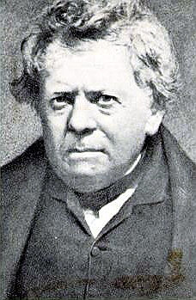
Topic B: The particulate nature of matter B.5 – Current and circuits
Ohm’s law
∙The German Ohm studied resistance of materials in the 1800s and in 1826 stated:
“Provided the temperature is kept constant, the resistance of very many materials is constant over a wide range of applied potential differences, and therefore the potential difference is proportional to the current.”
∙In formula form Ohm’s law looks like this:
V ∝ I
or V / I = CONST
or V = IR
Ohm’s law
FYI
∙Ohm’s law applies to components with constant R.
Notes:
‹#›
© 2006 By Timothy K. Lund

Slide 35
Topic B: The particulate nature of matter B.5 – Current and circuits
Ohm’s law – ohmic and non-ohmic behavior
∙A material is considered ohmic if it behaves according to Ohm’s law. In other words the resistance stays constant as the voltage changes.
EXAMPLE: Label appropriate V-I graphs with the following labels: ohmic, non-ohmic, R increasing, R decreasing, R constant.
SOLUTION:
∙First label the resistance dependence.
∙R = V / I so R is just the slope of the V vs. I graph.
∙Ohm’s law states the R is constant. Thus only one graph is ohmic.
V
V
V
non-ohmic
R⎯
R↓
non-ohmic
R↑
ohmic
I
I
I
Notes:
‹#›
© 2006 By Timothy K. Lund

Slide 36
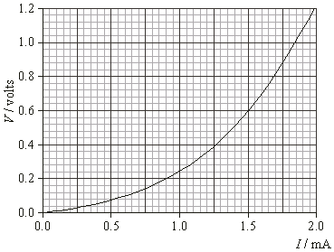
Topic B: The particulate nature of matter B.5 – Current and circuits
Ohm’s law – ohmic and non-ohmic behavior
EXAMPLE: The graph shows the applied voltage V vs. resulting current I through a tungsten filament lamp.
Find R when I = 0.5 mA and 1.5 mA. Is this filament ohmic or non-ohmic?
SOLUTION:
∙At 0.5 mA: V = 0.08 V
R = V / I = 0.08 / 0.5×10⁻³ = 160 Ω.
∙At 1.5 mA: V = 0.6 V
R = V / I = 0.6 / 1.5×10⁻³ = 400 Ω.
Since R is not constant the filament is non-ohmic.
Notes:
‹#›
© 2006 By Timothy K. Lund

Slide 37
Topic B: The particulate nature of matter B.5 – Current and circuits
Ohm’s law – ohmic and non-ohmic behavior
EXAMPLE: The graph shows the applied voltage V vs. resulting current I through a tungsten filament lamp.
Explain why a lamp filament might be non-ohmic.
SOLUTION:
∙The temperature coefficient for tungsten is positive, typical for conductors.
∙Therefore, the hotter the filament the higher R.
∙But the more current, the hotter a lamp filament burns.
∙Thus, the bigger the I the bigger the R.
Material
ρ (Ω⋅m)
α (C° ⁻¹)
Tungsten
5.6×10⁻⁸
4.5×10⁻³
Notes:
‹#›
© 2006 By Timothy K. Lund

Slide 38
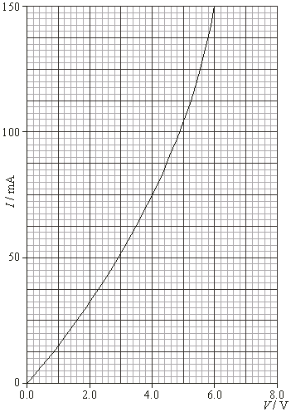
Topic B: The particulate nature of matter B.5 – Current and circuits
Ohm’s law – ohmic and non-ohmic behavior
EXAMPLE: The I-V characteristic is shown for a non-ohmic compo- nent. Sketch in the I-V character- istic for a 40 Ω ohmic component in the range of 0.0 V to 6.0 V.
SOLUTION:
∙”Ohmic” means V = IR and R is constant (and the graph is linear).
∙Thus V = I×40 or I = V / 40.
∙If V = 0, I = 0 / 40 = 0.0.
∙If V = 6, I = 6 / 40 = 0.15 A.
∙But 0.15 A = 150 mA.
Notes:
‹#›
© 2006 By Timothy K. Lund

Slide 39
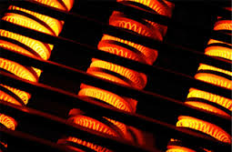
Topic B: The particulate nature of matter B.5 – Current and circuits
Power dissipation
∙Recall that power is the rate at which work is being done. Thus P = W / t.
∙From Topic 5.1 we learned that W = qV.
∙Thus
P = W / t
P = qV / t
P = (q / t)V
P = IV.
FYI
∙This power represents the energy per unit time delivered to, or consumed by, an electrical component having a current I and a potential difference V.
Notes:
‹#›
© 2006 By Timothy K. Lund

Slide 40
Topic B: The particulate nature of matter B.5 – Current and circuits
Power dissipation
PRACTICE: Use the definition of resistance R = V / I. together with the one we just derived (P = VI) to derive the following two formulas:
(a) P = I ²R
(b) P = V ²/ R.
SOLUTION:
(a) From R = V / I we get V = IR.
P = IV = I ( IR ) = I ²R.
(b) From R = V / I we get I = V / R.
P = IV = (V / R) (V) = V ²/ R.
P = VI = I ²R = V ²/ R
electrical power
Notes:
‹#›
© 2006 By Timothy K. Lund

Slide 41
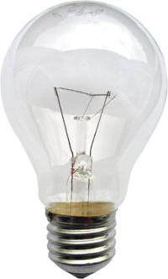
Topic B: The particulate nature of matter B.5 – Current and circuits
Power dissipation
PRACTICE:
The graph shows the V-I characteristics of a tungsten filament lamp.
What is its power consumption at I = 0.5 mA and at I = 1.5 mA?
SOLUTION:
∙At 0.5 mA, V = 0.08 V.
∙P = IV = (0.5×10⁻³)(0.08) = 4.0×10⁻⁵ W.
∙At 1.5 mA, V = 0.6 V.
∙P = IV = (1.5×10⁻³)(0.6) = 9.0×10⁻⁴ W.
Notes:
‹#›
© 2006 By Timothy K. Lund

Slide 42
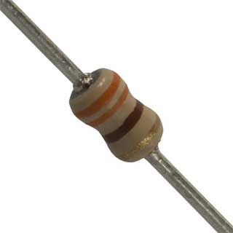

Topic B: The particulate nature of matter B.5 – Current and circuits
Electric circuits
∙An electric circuit is a set of conductors (like wires) and components (like resistors, lights, etc.) connected to an electrical voltage source (like a cell or a battery) in such a way that current can flow in complete loops.
∙Here are two circuits consisting of cells, resistors, and wires.
∙Note current flowing from (+) to (-) in each circuit.
triple-loop circuit
single-loop circuit
solder joints
Notes:
© 2006 By Timothy K. Lund

Slide 43


Topic B: The particulate nature of matter B.5 – Current and circuits
Circuit diagrams
∙A complete circuit will always contain a cell or a battery.
∙The schematic diagram of a cell is this:
∙A battery is just a group of cells connected in series:
∙If each cell is 1.5 V, then the battery above is 3(1.5) = 4.5 V. What is the voltage of your calculator battery?
∙A fixed-value resistor looks like this:
∙The schematic of a fixed-value resistor looks like this:
this is really a cell…
this is a battery…
this is the same battery…
this is a resistor…
Notes:
© 2006 By Timothy K. Lund

Slide 44


Topic B: The particulate nature of matter B.5 – Current and circuits
Drawing and interpreting circuit diagrams
EXAMPLE: Draw schematic diagrams of each of the following circuits:
SOLUTION:
Notes:
© 2006 By Timothy K. Lund

Slide 45
Topic B: The particulate nature of matter B.5 – Current and circuits
Investigating combinations of resistors in series
∙Resistors can be connected to one another in series, which means one after the other.
∙Note that there is only one current I and that I is the same for all series components.
∙Conservation of energy tells us qε = qV₁ + qV₂ + qV₃.
∙Thus ε = IR₁ + IR₂ + IR₃ from Ohm’s law V = IR
ε = I(R₁ + R₂ + R₃) factoring out I
ε = I(R), where R = R₁ + R₂ + R₃.
R₁
R₂
R₃
ε
R = R₁ + R₂ + …
equivalent resistance in series
Notes:
© 2006 By Timothy K. Lund

Slide 46
Topic B: The particulate nature of matter B.5 – Current and circuits
Investigating combinations of resistors in series
R₁
R₂
R₃
EXAMPLE: Three resistors of 330 Ω each are connected to a 6.0 V battery in series as shown.
(a) What is the circuit’s equivalent resistance?
(b) What is the current in the circuit?
SOLUTION:
(a) In series, R = R₁ + R₂ + R₃ so that
R = 330 + 330 + 330 = 990 Ω.
(b) Since the voltage on the entire circuit is 6.0 V, and since the total resistance is 990 Ω, from Ohm’s law we have I = V / R = 6 / 990 = 0.0061 A.
ε
Notes:
© 2006 By Timothy K. Lund

Slide 47
Topic B: The particulate nature of matter B.5 – Current and circuits
Investigating combinations of resistors in series
R₁
R₂
R₃
EXAMPLE: Three resistors of 330 Ω each are connected to a 6.0 V battery in series as shown.
(c) What is the voltage on each resistor?
SOLUTION:
(c) The current I we just found is the same everywhere. Thus each resistor has a current of I = 0.0061 A.
∙From Ohm’s law, each resistor has a voltage given by V = IR = (0.0061)(330) = 2.0 V.
ε
FYI
∙In series the V’s are different if the R’s are different.
Notes:
© 2006 By Timothy K. Lund

Slide 48
Topic B: The particulate nature of matter B.5 – Current and circuits
Investigating combinations of resistors in parallel
∙Resistors can also be in parallel.
∙In this circuit each resistor is connected directly to the cell.
∙Thus each resistor has the same voltage V and V is the same for all parallel components.
∙We can then write ε = V₁ = V₂ = V₃ ≡ V.
∙But there are three currents I₁, I₂, and I₃.
∙Since the total current I passes through the cell we see that I = I₁ + I₂ + I₃.
∙If R is the equivalent or total resistance of the three resistors, then I = I₁ + I₂ + I₃ becomes
ε / R = V₁ / R₁ + V₂ / R₂ + V₃ / R₃ Ohm’s law I = V / R
R₁
R₂
R₃
ε
Notes:
© 2006 By Timothy K. Lund

Slide 49
Topic B: The particulate nature of matter B.5 – Current and circuits
Investigating combinations of resistors in parallel
∙Resistors can also be in parallel.
∙In this circuit each resistor is connected directly to the cell.
∙Thus each resistor has the same voltage V and V is the same for all parallel components.
∙From ε = V₁ = V₂ = V₃ ≡ V
and ε / R = V₁ / R₁ + V₂ / R₂ + V₃ / R₃,
we get V / R = V / R₁ + V / R₂ + V / R₃.
∙Thus the equivalent resistance R is given by
R₁
R₂
R₃
ε
1 / R = 1 / R₁ + 1 / R₂ + …
equivalent resistance in parallel
Notes:
© 2006 By Timothy K. Lund

Slide 50
Topic B: The particulate nature of matter B.5 – Current and circuits
Investigating combinations of resistors in parallel
EXAMPLE: Three resistors of 330 Ω each are connected to a 6.0 V cell in parallel as shown.
(a) What is the circuit’s resistance?
(b) What is the voltage on each resistor?
SOLUTION:
(a) In parallel, 1 / R = 1 / R₁ + 1 / R₂ + 1 / R₃ so that
1 / R = 1 / 330 + 1 / 330 + 1 / 330 = 0.00909.
Thus R = 1 / 0.00909 = 110 Ω.
(b) The voltage on each resistor is 6.0 V, since the resistors are in parallel. (Each resistor is clearly directly connected to the battery).
R₁
R₂
R₃
ε
Notes:
© 2006 By Timothy K. Lund

Slide 51
Topic B: The particulate nature of matter B.5 – Current and circuits
Investigating combinations of resistors in parallel
EXAMPLE: Three resistors of 330 Ω each are connected to a 6.0 V cell in parallel as shown.
(c) What is the current in each resistor?
SOLUTION:
(c) Using Ohm’s law (I = V / R):
I₁ = V₁ / R₁ = 6 / 330 = 0.018 A.
I₂ = V₂ / R₂ = 6 / 330 = 0.018 A.
I₃ = V₃ / R₃ = 6 / 330 = 0.018 A.
R₁
R₂
R₃
ε
FYI
∙In parallel the I’s are different if the R’s are different.
Notes:
© 2006 By Timothy K. Lund

Slide 52


Topic B: The particulate nature of matter B.5 – Current and circuits
Circuit diagrams - voltmeters are connected in parallel
PRACTICE: Draw a schematic diagram for this circuit:
SOLUTION:
1.06
FYI
∙Be sure to position the voltmeter across the desired resistor in parallel.
Notes:
© 2006 By Timothy K. Lund

Slide 53
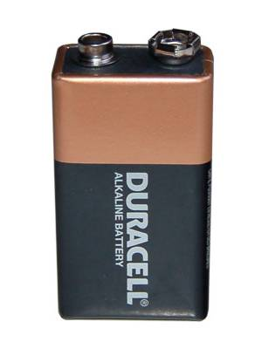
Topic B: The particulate nature of matter B.5 – Current and circuits
tenths place
Circuit diagrams - voltmeters are connected in parallel
EXAMPLE:
A battery’s voltage is measured as shown.
(a) What is the uncertainty in it’s measurement?
SOLUTION:
∙For digital devices always use the place value of the least significant digit as your raw uncertainty.
∙For this voltmeter the voltage is measured to the tenths place so we give the raw uncertainty a value of ∆V = ±0.1 V.
09.4
00.0
Notes:
‹#›
© 2006 By Timothy K. Lund

Slide 54
Topic B: The particulate nature of matter B.5 – Current and circuits
Circuit diagrams - voltmeters are connected in parallel
EXAMPLE:
A battery’s voltage is measured as shown.
(b) What is the fractional error in this measurement?
SOLUTION: Fractional error is just ΔV / V. For this particular measurement we then have
ΔV / V = 0.1 / 9.4 = 0.011 (or 1.1%).
09.4
FYI
∙When using a voltmeter the red lead is placed at the point of highest potential.
Notes:
‹#›
© 2006 By Timothy K. Lund

Slide 55

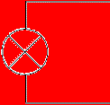


Topic B: The particulate nature of matter B.5 – Current and circuits
Circuit diagrams - voltmeters are connected in parallel
∙Consider the simple circuit of battery, lamp, and wire.
∙To measure the voltage of the circuit we merely connect the voltmeter while the circuit is in operation.
01.6
00.0
voltmeter
lamp
cell
in parallel
Notes:
‹#›
© 2006 By Timothy K. Lund

Slide 56



Topic B: The particulate nature of matter B.5 – Current and circuits
Circuit diagrams - ammeters are connected in series
∙To measure the current of the circuit we must break the circuit and insert the ammeter so that it intercepts all of the electrons that normally travel through the circuit.
00.2
00.0
ammeter
in series
lamp
cell
Notes:
‹#›
© 2006 By Timothy K. Lund

Slide 57

Topic B: The particulate nature of matter B.5 – Current and circuits
the circuit must be temporarily broken to insert the ammeter
Circuit diagrams - ammeters are connected in series
PRACTICE: Draw a schematic diagram for this circuit:
SOLUTION:
.003
FYI
∙Be sure to position the ammeter between the desired resistors in series.
Notes:
© 2006 By Timothy K. Lund

Slide 58
Topic B: The particulate nature of matter B.5 – Current and circuits
Circuit diagrams
PRACTICE: Draw a schematic diagram for this circuit:
SOLUTION:
FYI
∙This circuit is a combination series-parallel. In a later slide you will learn how to find the equivalent resistance of the combo circuit.
Notes:
© 2006 By Timothy K. Lund

Slide 59
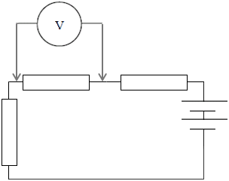
Topic B: The particulate nature of matter B.5 – Current and circuits
Ideal voltmeters - ∞ Ω resistance
∙Voltmeters are connected in parallel.
∙The voltmeter reads the voltage of only the component it is in parallel with.
∙The green current represents the amount of current the battery needs to supply to the voltmeter in order to make it register.
∙The red current is the amount of current the battery supplies to the original circuit.
∙In order to NOT ALTER the original properties of the circuit, ideal voltmeters have extremely high resistance (∞ Ω) to minimize the green current.
Notes:
© 2006 By Timothy K. Lund

Slide 60
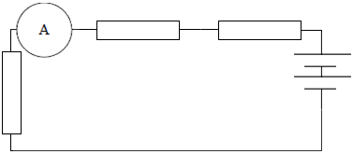
Topic B: The particulate nature of matter B.5 – Current and circuits
Ideal ammeters - 0 Ω resistance
∙Ammeters are connected in series.
∙The ammeter is supposed to read the current of the original circuit.
∙In order to NOT ALTER the original properties of the circuit, ideal ammeters have extremely low resistance (0 Ω) to minimize the effect on the red current.
Notes:
© 2006 By Timothy K. Lund

Slide 61
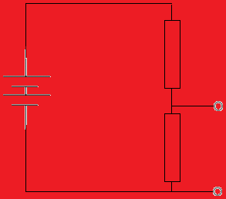

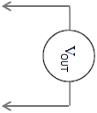
Topic B: The particulate nature of matter B.5 – Current and circuits
Potential divider circuits
∙Consider a battery of ε = 6 V. Suppose we have a light bulb that can only use three volts. How do we obtain 3 V from a 6 V battery?
∙A potential divider is a circuit made of two (or more) series resistors that allows us to tap off any voltage we want that is less than the battery voltage.
∙The input voltage is the emf of the battery.
∙The output voltage is the voltage drop across R₂.
∙Since the resistors are in series R = R₁ + R₂.
potential divider
R₁
R₂
Notes:
© 2006 By Timothy K. Lund

Slide 62
Topic B: The particulate nature of matter B.5 – Current and circuits
Potential divider circuits
∙Consider a battery of ε = 6 V. Suppose we have a light bulb that can only use three volts. How do we obtain 3 V from a 6 V battery?
∙From Ohm’s law the current I of the divider is given by I = V_{IN} / R = V_{IN} / (R₁ + R₂).
∙But V_{OUT} = V₂ = IR₂ so that
V_{OUT} = IR₂
= R₂×V_{IN} / (R₁ + R₂).
potential divider
R₁
R₂
V_{OUT} = V_{IN} [ R₂ / (R₁ + R₂) ]
potential divider
Notes:
© 2006 By Timothy K. Lund

Slide 63
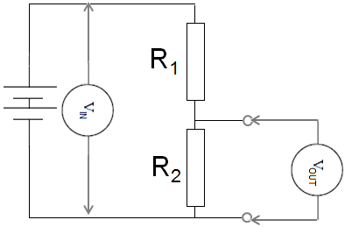
Topic B: The particulate nature of matter B.5 – Current and circuits
Potential divider circuits
PRACTICE:
Find the output voltage if the battery has an emf of 9.0 V, R₁ is a 2200 Ω resistor, and R₂ is a 330 Ω resistor.
SOLUTION:
∙Use V_{OUT} = V_{IN} [ R₂ / (R₁ + R₂) ]
V_{OUT} = 9 [ 330 / (2200 + 330) ]
V_{OUT} = 9 [ 330 / 2530 ] = 1.2 V.
FYI
∙The bigger R₂ is in comparison to R₁, the closer V_{OUT} is in proportion to the total voltage.
Notes:
© 2006 By Timothy K. Lund

Slide 64
Topic B: The particulate nature of matter B.5 – Current and circuits
Potential divider circuits
PRACTICE:
Find the value of R₂ if the battery has an emf of 9.0 V, R₁ is a 2200 Ω resistor, and we want an output voltage of 6 V.
SOLUTION:
∙Use the formula V_{OUT} = V_{IN} [ R₂ / (R₁ + R₂) ]. Thus
6 = 9 [ R₂ / (2200 + R₂) ]
6(2200 + R₂) = 9R₂
13200 + 6R₂ = 9R₂
13200 = 3R₂
R₂ = 4400 Ω
Notes:
© 2006 By Timothy K. Lund

Slide 65
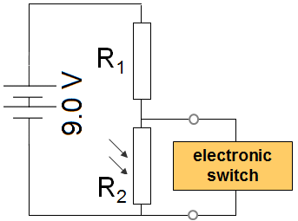
Topic B: The particulate nature of matter B.5 – Current and circuits
Potential divider circuits
PRACTICE: A light-dependent resistor (LDR) has R = 25 Ω in bright light and R = 22000 Ω in low light. An electronic switch will turn on a light when its p.d. is above 7.0 V. What should the value of R₁ be?
SOLUTION: Use V_{OUT} = V_{IN} [ R₂ / (R₁ + R₂) ]. Thus
7 = 9 [ 22000 / (R₁ + 22000) ]
7(R₁ + 22000) = 9(22000)
7R₁ + 154000 = 198000
7R₁ = 44000
R₁ = 6300 Ω (6286)
Notes:
© 2006 By Timothy K. Lund

Slide 66
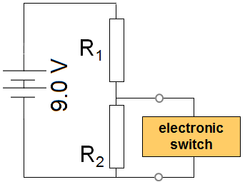
Topic B: The particulate nature of matter B.5 – Current and circuits
Potential divider circuits
PRACTICE: A thermistor has a resistance of 250 Ω when it is in the heat of a fire and a resistance of 65000 Ω when at room temperature. An electronic switch will turn on a sprinkler system when its p.d. is above 7.0 V.
(a) Should the thermistor be R₁ or R₂?
SOLUTION:
∙Because we want a high voltage at a high temperature, and because the thermistor’s resistance decreases with temperature, it should be placed at the R₁ position.
Notes:
© 2006 By Timothy K. Lund

Slide 67
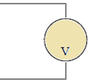
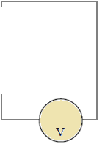
Topic B: The particulate nature of matter B.5 – Current and circuits
Potential divider circuits
PRACTICE: A thermistor has a resistance of 250 Ω when it is in the heat of a fire and a resistance of 65000 Ω when at room temperature. An electronic switch will turn on a sprinkler system when its p.d. is above 7.0 V.
(b) What should R₂ be?
SOLUTION: In fire the thermistor is R₁ = 250 Ω.
7 = 9 [ R₂ / (250 + R₂) ]
7(250 + R₂) = 9R₂
1750 + 7R₂ = 9R₂ → R₂ = 880 Ω (875)
Notes:
© 2006 By Timothy K. Lund

Slide 68
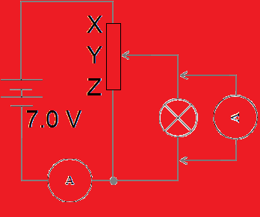
Topic B: The particulate nature of matter B.5 – Current and circuits
Potential divider circuits
PRACTICE: A filament lamp is rated at “4.0 V, 0.80 W” on its package. The potentiometer has a resistance from X to Z of 24 Ω and has linear variation.
(a) Sketch the variation of the p.d. V vs. the current I for a typical filament lamp. Is it ohmic?
SOLUTION: Since the temperature increases with the current, so does the resistance.
∙But from V = IR we see that R = V / I, which is the slope.
∙Thus the slope should increase with I.
ohmic means linear
V
non-ohmic
I
Notes:
© 2006 By Timothy K. Lund

Slide 69
Topic B: The particulate nature of matter B.5 – Current and circuits
Potential divider circuits
R₁
PRACTICE: A filament lamp is rated at “4.0 V, 0.80 W” on its package. The potentiometer has a resistance from X to Z of 24 Ω and has linear variation.
(b) The potentiometer is adjusted so that the meter shows 4.0 V. Will it’s contact be above Y, below Y, or exactly on Y?
SOLUTION: The circuit is acting like a potential divider with R₁ being the resistance between X and Y and R₂ being the resistance between Y and Z.
∙Since we need V_{OUT} = 4 V, and since V_{IN} = 7 V, the contact must be adjusted above the Y.
R₂
Notes:
© 2006 By Timothy K. Lund

Slide 70
Topic B: The particulate nature of matter B.5 – Current and circuits
Potential divider circuits
R₁
PRACTICE: A filament lamp is rated at “4.0 V, 0.80 W” on its package. The potentiometer has a resistance from X to Z of 24 Ω and has linear variation.
(c) The potentiometer is adjusted so that the meter shows 4.0 V. What are the current and the resistance of the lamp at this instant?
SOLUTION: P = 0.80 W and V = 4.0 V.
∙From P = IV we get 0.8 = I(4) so that I = 0.20 A.
∙From V = IR we get 4 = 0.2R so that R = 20. Ω.
∙You could also use P = I ²R for this last one.
R₂
Notes:
© 2006 By Timothy K. Lund

Slide 71
Topic B: The particulate nature of matter B.5 – Current and circuits
Potential divider circuits
R₁
PRACTICE: A filament lamp is rated at “4.0 V, 0.80 W” on its package. The potentiometer has a resistance from X to Z of 24 Ω and has linear variation.
(d) The potentiometer is adjusted so that the meter shows 4.0 V. What is the resistance of the Y-Z portion of the potentiometer?
SOLUTION: Let R₁ = X to Y and R₂ = Y to Z resistance.
∙Then R₁ + R₂ = 24 so that R₁ = 24 – R₂.
∙From V_{OUT} = V_{IN} [ R₂ / (R₁ + R₂) ] we get
4 = 7 [ R₂ / (24 – R₂ + R₂) ]
R₂
→ R₂ = 14 Ω (13.71).
Notes:
© 2006 By Timothy K. Lund

Slide 72
Topic B: The particulate nature of matter B.5 – Current and circuits
Potential divider circuits
R₁
PRACTICE: A filament lamp is rated at “4.0 V, 0.80 W” on its package. The potentiometer has a resistance from X to Z of 24 Ω and has linear variation.
(e) The potentiometer is adjusted so that the meter shows 4.0 V. What is the current in the Y-Z portion of the potentiometer?
SOLUTION:
∙V₂ = 4.0 V because it is in parallel with the lamp.
I₂ = V₂ / R₂
= 4 / 13.71 = 0.29 A
R₂
Notes:
© 2006 By Timothy K. Lund

Slide 73
Topic B: The particulate nature of matter B.5 – Current and circuits
Potential divider circuits
R₁
PRACTICE: A filament lamp is rated at “4.0 V, 0.80 W” on its package. The potentiometer has a resistance from X to Z of 24 Ω and has linear variation.
(f) The potentiometer is adjusted so that the meter shows 4.0 V. What is the current in the ammeter?
SOLUTION: The battery supplies two currents.
∙The red current is 0.29 A because it is the I₂ we just calculated in (e).
∙The green current is 0.20 A found in (c).
∙The ammeter has both so I = 0.29 + 0.20 = 0.49 A.
R₂
Notes:
© 2006 By Timothy K. Lund

Slide 74
Topic B: The particulate nature of matter B.5 – Current and circuits
Solving problems involving circuits
PRACTICE: A battery is connected to a 25-W lamp as shown.
What is the lamp’s resistance?
SOLUTION:
Suppose we connect a voltmeter to the circuit.
∙We know P = 25 W.
∙We know V = 1.4 V.
∙From P = V ² / R we get
∙R = V ²/ P = 1.4 ² / 25 = 0.078 Ω.
01.4
00.0
Notes:
‹#›
© 2006 By Timothy K. Lund

Slide 75
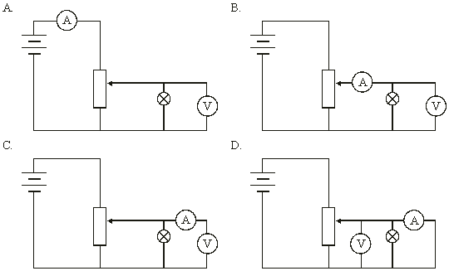
Topic B: The particulate nature of matter B.5 – Current and circuits
Solving problems involving circuits
PRACTICE: Which circuit shows the correct setup to find the V-I characteristics of a filament lamp?
SOLUTION:
∙The voltmeter must be in parallel with the lamp.
∙It IS, in ALL cases.
∙The ammeter must be in series with the lamp and must read only the lamp’s current.
∙The correct response is B.
two currents
lamp current
no currents
short circuit!
Notes:
© 2006 By Timothy K. Lund

Slide 76
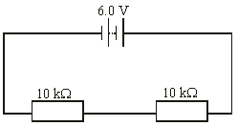
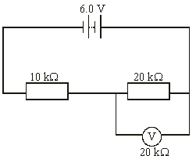
Topic B: The particulate nature of matter B.5 – Current and circuits
equivalent ckt
Solving problems involving circuits
PRACTICE: A non-ideal voltmeter is used to measure the p.d. of the 20 kΩ resistor as shown. What will its reading be?
SOLUTION: There are two currents in the circuit because the voltmeter does not have a high enough resistance to prevent the green one from flowing.
∙The 20 kΩ resistor is in parallel with the 20 kΩ so that
1 / R = 1 / 20000 + 1 / 20000 = 2 / 20000.
R = 20000 / 2 = 10 kΩ.
∙But then we have two 10 kΩ resistors in series and each takes half the battery voltage, or 3 V.
Notes:
© 2006 By Timothy K. Lund

Slide 77
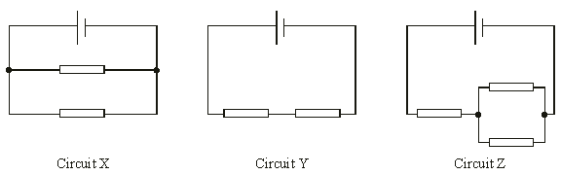
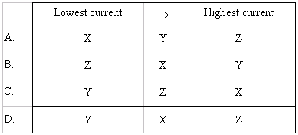
Topic B: The particulate nature of matter B.5 – Current and circuits
Solving problems involving circuits
PRACTICE: All three circuits use the same resistors and the same cells.
Which one of the following shows the correct ranking for the currents passing through the cells?
SOLUTION: The bigger the R the smaller the I.
Highest I
Lowest I
Middle I
1.5R
0.5R
2R
R
0.5R
parallel
series
combo
Notes:
© 2006 By Timothy K. Lund

Slide 78
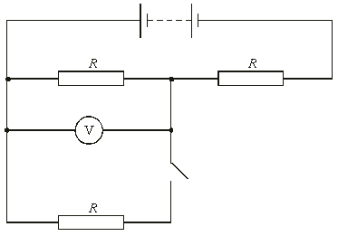
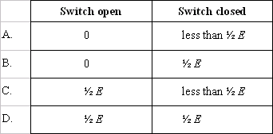
Topic B: The particulate nature of matter B.5 – Current and circuits
Solving problems involving circuits
E
PRACTICE: The voltmeter has infinite resistance.
What are the readings on the voltmeter when the switch is open and closed?
SOLUTION:
∙With the switch open the green R is not part of the circuit. Red and orange split the battery emf.
∙With the switch closed the red and green are in parallel and are (1/2)R.
Notes:
© 2006 By Timothy K. Lund

Slide 79
Topic B: The particulate nature of matter B.5 – Current and circuits
Cells
∙To make a chemical cell, or a battery, you can begin with a container of weak acid, and two electrodes made of different metals.
∙Different metals dissolve in acids at different rates.
∙When a metal dissolves, it enters the acid as a positive ion, leaving behind an electron.
∙We call the weak acid the electrolyte. We call the least negative metal the positive terminal. We call the most negative metal the negative terminal.
(+)
(-)
-
-
-
-
-
+
+
+
+
+
-
-
-
-
-
-
-
-
+
+
+
+
+
+
+
+
Weak Acid
The chemical cell
Electrolyte
Notes:
© 2014 By Timothy K. Lund

Slide 80
Topic B: The particulate nature of matter B.5 – Current and circuits
Cells
∙Think of a chemical cell as a device that converts chemical energy into electrical energy.
∙If we connect conductors and a light bulb to the (+) and the (-) terminals, we see that electrons begin to flow in an electric current.
+
-
(+)
(-)
-
-
-
-
-
+
+
+
+
+
-
-
-
-
-
-
-
-
+
+
+
+
+
+
+
+
FYI
∙Why do the electrons run from (-) to (+) in the external circuit instead of the reverse?
The chemical cell
Electrolyte
Notes:
© 2014 By Timothy K. Lund

Slide 81
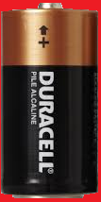

Topic B: The particulate nature of matter B.5 – Current and circuits
Cells – primary and secondary
∙Each time an electron leaves the (-), the acid creates another electron.
∙Each time an electron enters the (+), the acid neutralizes an electron.
∙This process is maintained until one of the metals or the electrolyte is completely used up.
∙A primary cell can’t be recharged.
∙A secondary cell can be recharged by applying an external voltage, reversing the chemical reaction.
+
-
(+)
(-)
-
-
-
-
-
+
+
+
+
+
-
-
-
-
-
-
-
-
+
+
+
+
+
+
+
+
The chemical cell
Electrolyte
Notes:
© 2014 By Timothy K. Lund

Slide 82
Topic B: The particulate nature of matter B.5 – Current and circuits
Cells – current
PRACTICE: A current isn’t really just one electron moving through a circuit. It is in reality more like a chain of them, each one shoving the next through the circuit. Recalling the charge law “like charges repel, and unlike charges attract,” explain why the current flows from (-) to (+) in terms of the force of repulsion.
SOLUTION:
∙Consider electrons at A and B.
∙Both electrons feel a repulsive force at their respective electrodes.
+
-
(+)
B
A
(-)
-
-
-
-
-
+
+
+
+
+
-
-
-
-
-
-
-
-
+
+
+
+
+
+
+
+
The chemical cell
Electrolyte
Notes:
© 2014 By Timothy K. Lund

Slide 83
Topic B: The particulate nature of matter B.5 – Current and circuits
Cells – current
PRACTICE: A current isn’t really just one electron moving through a circuit. It is in reality more like a chain of them, each one shoving the next through the circuit. Recalling the charge law “like charges repel, and unlike charges attract,” explain why the current flows from (-) to (+) in terms of the force of repulsion.
SOLUTION:
∙But A’s is bigger than B’s because there are more negatives repelling at A than B. Thus A wins.
+
-
(+)
B
A
(-)
-
-
-
-
-
+
+
+
+
+
-
-
-
-
-
-
-
-
+
+
+
+
+
+
+
+
The chemical cell
Electrolyte
Notes:
© 2014 By Timothy K. Lund

Slide 84
Topic B: The particulate nature of matter B.5 – Current and circuits
Cells – electric potential energy
PRACTICE: Consider electrons at points A and B. Which one has more potential energy?
SOLUTION:
∙The electron at B has already traveled through the circuit and is returning to the cell so it can do no more work on the bulb.
∙The electron at A still has the full circuit to travel and can thus still do work on the bulb.
∙Thus the electron at A has more potential energy.
+
-
(+)
B
A
(-)
-
-
-
-
-
+
+
+
+
+
-
-
-
-
-
-
-
-
+
+
+
+
+
+
+
+
The chemical cell
Electrolyte
Notes:
© 2014 By Timothy K. Lund

Slide 85
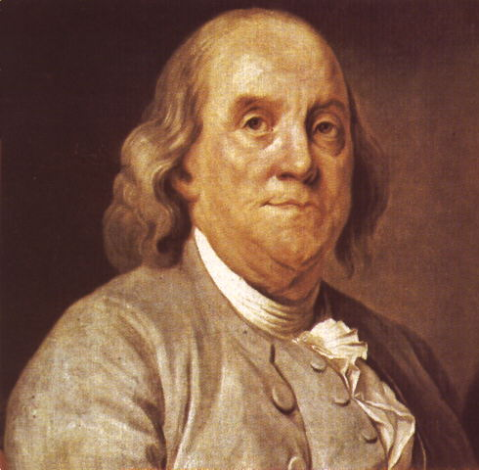
Topic B: The particulate nature of matter B.5 – Current and circuits
Cells – conventional current
∙Back in the days of Ben Franklin scientists understood that there were two types of electricity: positive and negative.
∙What they didn’t know was which one was actually free to travel through a circuit.
∙The influential Ben Franklin guessed wrongly that it was the positive charge.
∙Thus, his vision of our chemical cell looked like the one on the next slide.
+
-
(+)
(-)
-
-
-
-
-
+
+
+
+
+
-
-
-
-
-
-
-
-
+
+
+
+
+
+
+
+
The chemical cell
Electrolyte
Notes:
© 2014 By Timothy K. Lund

Slide 86
Topic B: The particulate nature of matter B.5 – Current and circuits
Cells – conventional current
We will use only conventional current in this course.
+
-
+
-
(+)
(-)
(+)
(-)
+
+
+
+
+
+
+
+
-
-
-
-
-
-
-
-
+
+
+
+
+
-
-
-
-
-
FYI
∙Positive charge flow is called conventional current and is still used in circuit analysis.
-
-
-
-
-
+
+
+
+
+
-
-
-
-
-
-
-
-
+
+
+
+
+
+
+
+
= more positive
= less positive
less negative
more negative
Franklin’s chemical cell
The chemical cell
Electrolyte
Electrolyte
Notes:
© 2014 By Timothy K. Lund

Slide 87
Topic B: The particulate nature of matter B.5 – Current and circuits
Cells – electric potential energy
PRACTICE: Consider positive charges at points A and B. Which one has more potential energy?
SOLUTION:
∙The charge at B has already traveled through the circuit and is returning to the battery so it can do no more work on the bulb.
∙The charge at A still has the full circuit to travel and can thus still do work on the bulb.
∙Thus the positive charge at A has more potential energy.
+
-
(+)
A
B
(-)
+
+
+
+
+
+
+
+
-
-
-
-
-
-
-
-
+
+
+
+
+
-
-
-
-
-
Franklin’s chemical cell
Electrolyte
Notes:
© 2014 By Timothy K. Lund

Slide 88
Topic B: The particulate nature of matter B.5 – Current and circuits
Cells – electric potential difference
∙We define the electric potential difference ∆V as the amount of work done in moving a positive charge q from a point of lower potential energy to a point of higher potential energy.
∙The units for electric potential difference are volts V or, as can be seen from the formula, J C⁻¹.
+
-
(+)
(-)
∆V = ∆E_{P} / q
potential difference
+
+
+
+
+
+
+
+
-
-
-
-
-
-
-
-
+
+
+
+
+
-
-
-
-
-
FYI ∙Electric potential difference is often abbreviated p.d.
Electrolyte
Notes:
© 2014 By Timothy K. Lund

Slide 89



Topic B: The particulate nature of matter B.5 – Current and circuits
Cells – electric potential difference
∙Think of a battery as an engine that uses chemical energy to take positive charges and move them from low to high potential within the cell so that they can do work outside the cell in the external circuit.
∙The schematic symbol for a switch is shown.
∙For this circuit we have the schematic:
+
-
(+)
(-)
lamp
high potential
low potential
switch
Chemical energy
cell
(+)
(-)
Electrolyte
Notes:
© 2014 By Timothy K. Lund

Slide 90
Topic B: The particulate nature of matter B.5 – Current and circuits
Cells – electric potential difference
∙As an analogy to gravitational potential energy, think of the chemical cell as an elevator, powered by a chemical engine.
∙Inside the cell, positive charges at low potential are raised through chemical energy to high potential.
∙Outside the cell, positive charges at high potential are released into the external circuit to do their electrical work, losing energy as they go.
(+)
(-)
chemical cell
external circuit
Notes:
© 2014 By Timothy K. Lund

Slide 91
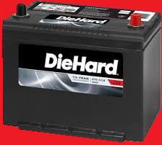
Topic B: The particulate nature of matter B.5 – Current and circuits
Cells – electric potential difference
EXAMPLE:
200 μC of charge is brought from an electric potential of 2.0 V to an electric potential of 14 V through use of a car battery. What is the change in potential energy of the charge?
SOLUTION:
∙From ∆V = ∆E_{P} / q we see that ∆E_{P} = q∆V. Thus
∆E_{P} = q(V – V₀)
∆E_{P} = (200×10⁻⁶)(14 – 2)
∆E_{P} = 0.0024 J.
FYI
∙Note the increase rather than the decrease.
Notes:
© 2014 By Timothy K. Lund

Slide 92
Topic B: The particulate nature of matter B.5 – Current and circuits
Cells – electromotive force (emf)
∙The electromotive force ε (or emf) of a cell is the amount of chemical energy converted to electrical energy per unit charge.
∙Since energy per unit charge is volts, emf is measured in volts.
∙This cell has an emf of ε = 1.6 V.
∙Because the cell is not connected to any circuit we say that it is unloaded.
01.6
00.0
Notes:
© 2014 By Timothy K. Lund

Slide 93
Topic B: The particulate nature of matter B.5 – Current and circuits
Cells – electromotive force (emf)
EXAMPLE: How much chemical energy is converted to electrical energy by the cell if a charge of 15 μC is drawn by the voltmeter?
SOLUTION:
∙From ∆V = ∆E_{P} / q we have ε = ∆E_{P} / q.
∙Thus
∆E_{P} = εq
= (1.6)(15×10⁻⁶)
= 2.4×10⁻⁵ J.
01.6
Notes:
© 2014 By Timothy K. Lund

Slide 94
Topic B: The particulate nature of matter B.5 – Current and circuits
Cells – internal resistance
∙If we connect a resistor as part of an external circuit, we see that the voltage read by the meter goes down a little bit.
∙We say that the cell is loaded because there is a resistor connected externally in a circuit.
∙This cell has a loaded potential difference (p.d.) of V = 1.5 V.
01.5
01.6
Notes:
© 2014 By Timothy K. Lund

Slide 95
Topic B: The particulate nature of matter B.5 – Current and circuits
Cells – internal resistance
∙All cells and batteries have limits as to how rapidly the chemical reactions can maintain the voltage.
∙There is an internal resistance r associated with a cell or a battery which causes the cell’s voltage to drop when there is an external demand for the cell’s electrical energy.
∙The best cells will have small internal resistances.
∙The internal resistance of a cell is why a battery becomes hot if there is a high demand for current from an external circuit.
∙Cell heat will be produced at the rate given by
P = I ²r
r = cell internal resistance
cell heat rate
Notes:
© 2014 By Timothy K. Lund

Slide 96

Topic B: The particulate nature of matter B.5 – Current and circuits
Cells – internal resistance
PRACTICE: A battery has an internal resistance of r = 1.25 Ω. What is its rate of heat production if it is supplying an external circuit with a current of I = 2.00 A?
SOLUTION:
∙Rate of heat production is power.
∙P = I ²r
∙P = (2 ²)(1.25) = 5.00 J s⁻¹ (5.00 W.)
FYI
∙If you double the current, the rate of heat generation will quadruple because of the I ² dependency.
∙If you accidentally “short circuit” a battery, the battery may even heat up enough to leak or explode!
Notes:
© 2014 By Timothy K. Lund

Slide 97


Topic B: The particulate nature of matter B.5 – Current and circuits
Cells – internal resistance
∙If we wish to consider the internal resistance of a cell, we can use the cell and the resistor symbols together, like this:
∙And we may enclose the whole cell in a box of some sort to show that it is one unit.
∙Suppose we connect our cell with its internal resistance r to an external circuit consisting of a single resistor of value R.
∙All of the chemical energy from the battery is being consumed by the internal resistance r and the external load represented by the resistance R.
ε
r
ε
R
r
Notes:
© 2014 By Timothy K. Lund

Slide 98

Topic B: The particulate nature of matter B.5 – Current and circuits
Cells – internal resistance
∙From E_{P} = qV we can deduce that the electrical energy being created by the cell is E_{P} = qε.
∙The electrical energy being converted to heat energy by R is E_{P,R} = qV_{R}.
∙The electrical energy being converted to heat energy by r is E_{P,r} = qV_{r}.
∙From conservation of energy E_{P} = E_{P,R} + E_{P,r} so that qε = qV_{R} + qV_{r}.
∙Note that the current I is the same everywhere.
∙From Ohm’s law V_{R} = IR and V_{r} = Ir so that ε = IR + Ir.
ε = IR + Ir = I(R + r)
emf relationship
Notes:
© 2014 By Timothy K. Lund

Slide 99

Topic B: The particulate nature of matter B.5 – Current and circuits
Cells – internal resistance
EXAMPLE:
A cell has an unloaded voltage of 1.6 V and a loaded voltage of 1.5 V when a 330 Ω resistor is connected as shown.
Find ε. (b) Find I.
(c) Find the cell’s internal resistance.
SOLUTION:
(a) From the first schematic we see that ε = 1.6 V. (Unloaded cell.)
(b) From the second diagram we see that the voltage across the 330 Ω resistor is 1.5 V. (Loaded cell.)
∙V = IR so that 1.5 = I(330) and I = 0.0045 A.
1.6 V
1.5 V
Notes:
© 2014 By Timothy K. Lund

Slide 100
Topic B: The particulate nature of matter B.5 – Current and circuits
Cells – internal resistance
EXAMPLE:
A cell has an unloaded voltage of 1.6 V and a loaded voltage of 1.5 V when a 330 Ω resistor is connected as shown.
Find ε. (b) Find I.
(c) Find the cell’s internal resistance.
SOLUTION:
(c) Use the emf relationship ε = IR + Ir.
1.6 = (0.0045)(330) + (0.0045)r
1.6 = 1.5 + 0.0045r
0.1 = 0.0045r
1.6 V
1.5 V
→ r = 22 Ω.
Notes:
© 2014 By Timothy K. Lund

Slide 101
Topic B: The particulate nature of matter B.5 – Current and circuits
Cells – terminal potential difference
EXAMPLE:
A cell has an unloaded voltage of 1.6 V and a loaded voltage of 1.5 V when a 330 Ω resistor is connected as shown.
(d) What is the terminal potential difference (t.p.d.) of the cell?
SOLUTION:
(d) The terminal potential difference is the potential difference at the terminals of the cell where it connects to the external circuit.
∙This cell has an unloaded t.p.d of 1.6 V, and a loaded t.p.d. of 1.5 V. Note that the t.p.d. depends on the load.
1.6 V
1.5 V
Notes:
© 2014 By Timothy K. Lund

